Slide 1
<?php is Fun! ?>
Henry, C-DAC

Slide 2
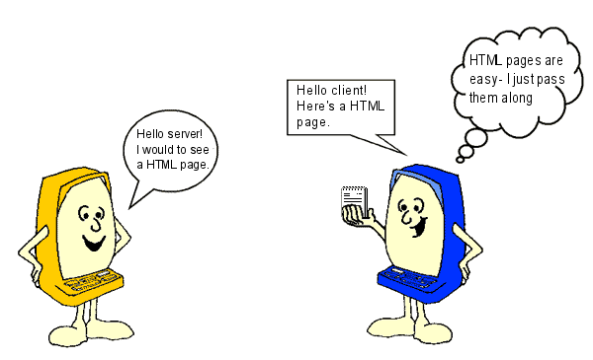
How does HTML work?
Henry, C-DAC

Slide 3
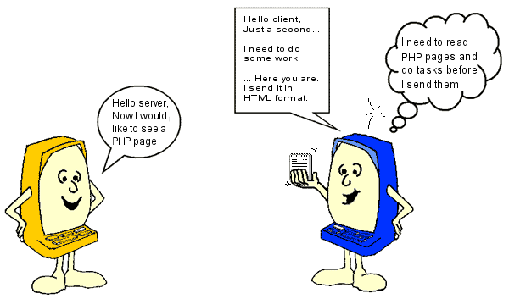
How does PHP work?
Henry, C-DAC

Slide 4
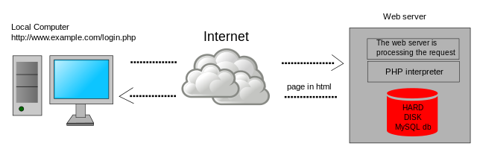
How does PHP Work?
Henry, C-DAC

Slide 5
What You Should Already Know
HTML
CSS
JavaScript
Henry, C-DAC

Slide 6
Why do you need PHP?
Server side scripting language
  Develop dynamic web apps
  Interfaces with DB, Mail, Third party tools & parsers
  Authenticate users
  Validate & Process forms securely etc…
Open Source and Cross-Platform
Henry, C-DAC

Slide 7

Rasmus Lerdorf
Who is this guy?
In 1994, Rasmus Lerdorf developed this PHP as a Perl Hack. He had called it as Personal Home Page Tools (PHP Tools) for tracking his online resume.
Henry, C-DAC

Slide 8
Brief History
PHP/FI 1.0 source code was released in 1995
With Zeev Suraski and Andi Gutmans a new parser engine was created and named as PHP: Hypertext Preprocessor
PHP 3.0 released in 1998
PHP 5 is re-written by Zend(www.zend.com) to include a number of features, such as an object model.
The latest version of PHP is 7.0 – php.net
Henry, C-DAC
Notes:
Then the brief history of the PHP.
PHP/FI 2.0 was released in 1997
PHP 4.4 released in 2005
PHP 5.0 released in 2004
PHP 5.3 released in 2009
Zend is a commercial enterprise.
It provides Zend engine for PHP for free
They also provide other products and services for a fee.

Slide 9
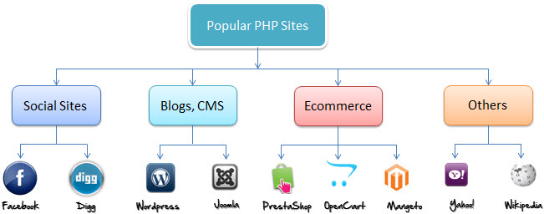
PHP Market Share
Henry, C-DAC

Slide 10
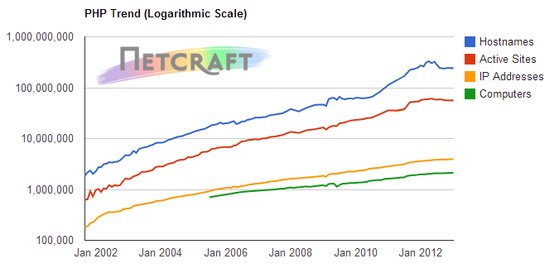
PHP Just grows & grows
At the end of January 2013, PHP was being used by a remarkable 244M sites
Henry, C-DAC

Slide 11
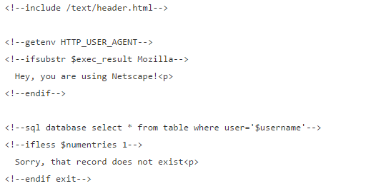
First FI Code…
Henry, C-DAC

Slide 12
PHP - Setup
A web hosting account that supports the use of PHP web pages and grants you access to MySQL databases
Have PHP and MySQL installed on your own computer
Henry, C-DAC

Slide 13
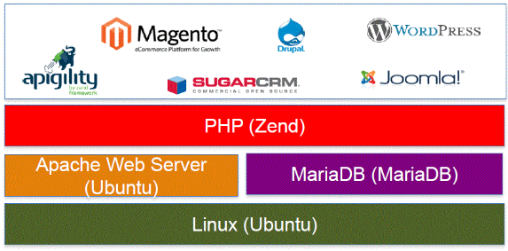
PHP Stack
Henry, C-DAC

Slide 14



PHP Stack
Henry, C-DAC

Slide 15
The Setup we’ll be using…
Linux
PHP
Apache Web Server
MySQL
GD Library
PDFLib
SimpleXML
Etc…
Henry, C-DAC

Slide 16
What is a PHP File?
PHP files can contain text, HTML, CSS, JavaScript, and PHP code
PHP codes are executed on the server, and the result is returned to the browser as plain HTML
PHP files have extension ".php"
Henry, C-DAC

Slide 17
Basic Syntax
<?php
// PHP code goes here
?>
Henry, C-DAC
Notes:
Typically file ends in .php (Set in the web server configuration)
Programming lines should end in ';' or you get an error
The php code is not visible on the browser as it is a server side language.
As with HTML, Whitespace is ignored between PHP statements.

Slide 18
Should I use PHP short_open_tag?
Issue here is…
  PHP managed to choose a tag (<?) that was used by XML.
  E.g., <?xml version="1.0" encoding="UTF-8" ?>
Causes issue with XML parsing.
Henry, C-DAC

Slide 19
Hello World…
  Hello.php
  <h3>My example</h3>
    <?php
      echo “<h2>Welcome to this ACTS PHP course</h2>”;
    ?>
Henry, C-DAC

Slide 20
So, What did you see in hello.php
Henry, C-DAC

Slide 21
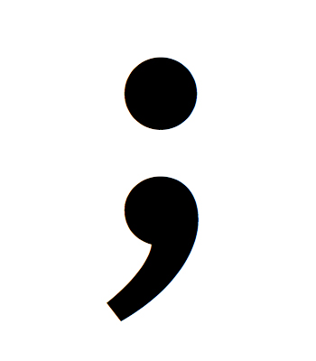
The Semicolon;
The semicolon signifies the end of a PHP statement and should never be forgotten.
Henry, C-DAC

Slide 22
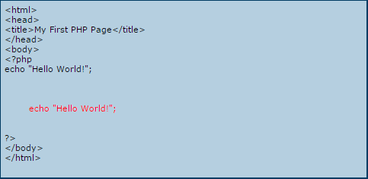
The Whitespace
Whitespace is ignored between PHP statements
You can write one line of PHP code, then 20 lines of blank space before the next line of PHP code
Henry, C-DAC

Slide 23
2-Ways of scripting
You can embed sections of php inside html:
<html>
<body>
<?php echo "Hello World!"; ?>
</body>
</html>
Henry, C-DAC
Notes:
You need to be careful while echoing the HTML contents. You need to properly escape the HTML double quotes.

Slide 24
2-Ways of scripting
Or you can echo html from php:
<?php
echo "<html>”;
echo “<head><title>Howdy</title></head>”;
echo “<body><p>Am from inside PHP code</p><body>”;
echo “</html>”;
?>
Henry, C-DAC
Notes:
You need to be careful while echoing the HTML contents. You need to properly escape the HTML double quotes.

Slide 25
Echo in PHP
Difference between function and language construct?
Henry, C-DAC

Slide 26
Language constructs in PHP
print()
unset()
isset()
empty()
include()
require()
die()
echo ()
Henry, C-DAC

Slide 27
Echo and Print Statements
The PHP echo/print statement is often used to output data to the screen.
<?php
$txt = “PHP";
echo "I love $txt!";
print "<h2>$txt</h2>";
?>
Henry, C-DAC

Slide 28
Echo and Print
echo and print is not actually a function (it is a language construct)
You are not required to use parentheses with it
Tutorial @ http://techglimpse.com/difference-between-echo-print-php-examples/
Henry, C-DAC

Slide 29
Comments
One Line comments
<?php
// One line comment
# one line comment
?>
DocBlock Comment
<?php
/*
* This function does nothing
* @param string $bar
* @return void
*/
?>
  Multi-Line comment
<?php
/*
Multi-line comment
*/
?>
Henry, C-DAC

Slide 30
phpinfo()
First script to try out
Henry, C-DAC

Slide 31
But not safe to keep phpinfo enabled?
Henry, C-DAC

Slide 32
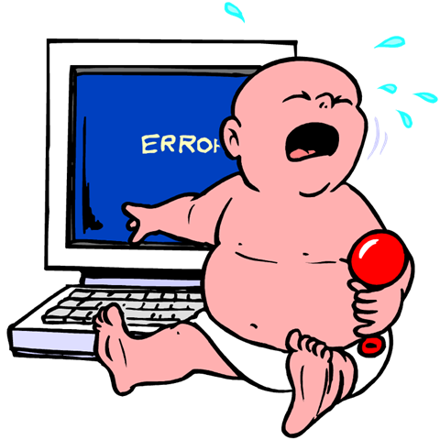
Errors?
Henry, C-DAC

Slide 33

Variables
<?php
$txt="Hello world!";
$x=5;
$y=10.5;
?>
PHP has no command to declare variables. The variable is created the moment you assign a value to it.
Henry, C-DAC

Slide 34
Variables
<?php
$txt="Hello world!";
$x=5;
$y=10.5;
?>
Wait…Where is the data type?
PHP automatically converts the variable to the correct data type, depending on its value.
Henry, C-DAC
Notes:
Loosely Typed Language

Slide 35
Pretty Prints…
print_r()
  Prints human-readable information about a variable
and var_dump() will dump structured information about a variable including its type and value.
Henry, C-DAC

Slide 36
PHP Variables
Rules for PHP variables:
  A variable starts with the $ sign, followed by the name of the variable
  A variable name must start with a letter or the underscore character
  A variable name cannot start with a number
  A variable name can only contain alpha-numeric characters and underscores (A-z, 0-9, and _ )
  Variable names are case-sensitive ($age and $AGE are two different variables)
Henry, C-DAC

Slide 37
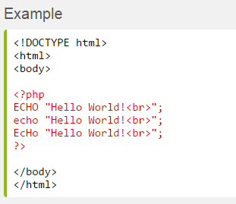
PHP Case Sensitivity
All keywords (e.g. if, else, while, echo, etc.), classes, functions, and user-defined functions are NOT case-sensitive
In the example below, all three echo statements below are legal (and equal):
Henry, C-DAC

Slide 38
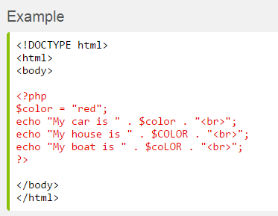
PHP Case Sensitivity
However; all variable names are case-sensitive.
Only the first statement will display the value of the $color variable (this is because $color, $COLOR, and $coLOR are treated as three different variables):
Henry, C-DAC

Slide 39
Variable Types and its Scope
Henry, C-DAC

Slide 40
Scope
<?php
$x=5; // global scope
function myTest()
{
$y=10; // local scope
echo "<p>Test variables inside the function:<p>";
echo "Variable x is: $x";
echo "<br>";
echo "Variable y is: $y";
}
myTest();
echo "<p>Test variables outside the function:<p>";
echo "Variable x is: $x";
echo "<br>";
echo "Variable y is: $y";
?>
Henry, C-DAC
Notes:
When we output the values of the two variables inside the myTest() function, it prints the value of $y as it is the locally declared, but cannot print the value of $x since it is created outside the function.
Then, when we output the values of the two variables outside the myTest() function, it prints the value of $x, but cannot print the value of $y since it is a local variable and it is created inside the myTest() function.

Slide 41
Global Keyword
The global keyword is used to access a global variable from within a function.
<?php
$x=5; // global scope
function myTest()
{
global $x;
$y=10; // local scope
echo "<p>Test variables inside the function:<p>";
echo "Variable x is: $x";
echo "<br>";
echo "Variable y is: $y";
}
myTest();
echo "<p>Test variables outside the function:<p>";
echo "Variable x is: $x";
echo "<br>";
echo "Variable y is: $y";
?>
Henry, C-DAC

Slide 42
Or use $GLOBALS
$GLOBALS — References all variables available in global scope
<?php
$x = 75;
$y = 25;
function addition() {
$GLOBALS['z'] = $GLOBALS['x'] + $GLOBALS['y'];
}
addition();
echo "<h2>" . $z . "</h2>";
?>
Henry, C-DAC

Slide 43
$GLOBALS
$GLOBALS is a 'superglobal', or automatic global, variable.
This simply means that it is available in all scopes throughout a script. There is no need to do global $variable; to access it within functions or methods.
Henry, C-DAC

Slide 44
Static variable
Normally, when a function is completed/executed, all of its variables are deleted. However, sometimes we want a local variable NOT to be deleted. We need it for a further job.
<?php
function myTest()
{
static $x=0;
echo $x;
$x++;
}
myTest();
myTest();
myTest();
?>
Henry, C-DAC

Slide 45
Super Global variables Variables
PHP programming language provides lot of predefined variables.
Superglobals are always accessible, regardless of scope - and you can access them from any function, class or file without having to do anything special
Henry, C-DAC
Notes:
- Typed by context (but one can force type), so it's loose
Begin with "$" (unlike javascript!)
$_SERVER[PHP_SELF];
$_SERVER[SERVER_NAME];
$_SERVER[REQUEST_URI];

Slide 46
Super Global variables Variables
  $_SERVER - Server and execution environment information
  $_GET - HTTP GET variables
  $_POST - HTTP POST variables
  $_FILES - HTTP File Upload variables
  $_SESSION - Session variables
  $_REQUEST
  $_COOKIE
  $GLOBALS
Henry, C-DAC
Notes:
- Typed by context (but one can force type), so it's loose
Begin with "$" (unlike javascript!)
$_SERVER[PHP_SELF];
$_SERVER[SERVER_NAME];
$_SERVER[REQUEST_URI];

Slide 47
$_SERVER
_SERVER['PHP_SELF'] | Returns the filename of the currently executing script
$_SERVER['GATEWAY_INTERFACE'] | Returns the version of the Common Gateway Interface (CGI) the server is using
$_SERVER['SERVER_ADDR'] | Returns the IP address of the host server
$_SERVER['SERVER_NAME'] | Returns the name of the host server (such as www.w3schools.com)
$_SERVER['SERVER_SOFTWARE'] | Returns the server identification string (such as Apache/2.2.24)
$_SERVER['SERVER_PROTOCOL'] | Returns the name and revision of the information protocol (such as HTTP/1.1)
$_SERVER['REQUEST_METHOD'] | Returns the request method used to access the page (such as POST)
$_SERVER['REQUEST_TIME'] | Returns the timestamp of the start of the request (such as 1377687496)
$_SERVER['QUERY_STRING'] | Returns the query string if the page is accessed via a query string
$_SERVER['HTTP_ACCEPT'] | Returns the Accept header from the current request
$_SERVER['HTTP_ACCEPT_CHARSET'] | Returns the Accept_Charset header from the current request (such as utf-8,ISO-8859-1)
$_SERVER['HTTP_HOST'] | Returns the Host header from the current request
$_SERVER['HTTP_REFERER'] | Returns the complete URL of the current page (not reliable because not all user-agents support it)
$_SERVER['HTTPS'] | Is the script queried through a secure HTTP protocol
Henry, C-DAC

Slide 48
Primitive Data Types
Henry, C-DAC

Slide 49
Primitive Data Types
PHP supports eight primitive types.
Four scalar types:
    boolean
    Integer
    float (floating-point number, aka double)
    string
Two compound types:
    array
    object
And finally two special types:
    Resource - A resource is a special variable, holding a reference to an external resource. Resources are created and used by special functions.
    NULL - The special NULL value represents a variable with no value. NULL is the only possible value of type null.
Henry, C-DAC

Slide 50
Primitive Data Types
<?php
$isPhpProgrammer = true; //boolean
$howOldIsPhp = 15; // integer
$pi = 3.14; // float
$event = "Acts Course"; // string
$cars=array("Volvo","BMW","Toyota");
?>
Henry, C-DAC

Slide 51
Primitive Data Types
// Object type
<?php
class foo
{
function do_foo()
{
echo "Doing foo.";
}
}
$bar = new foo;
$bar->do_foo();
$var = NULL; // Null
?>
Henry, C-DAC

Slide 52
Operators
Assignment Operators
Arithmetic Operators
Comparison Operators
Logical Operators
String Operators
Combination of Arithmetic & Assignment Operators
Henry, C-DAC

Slide 53
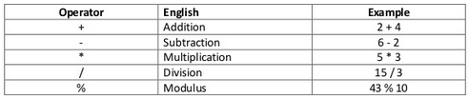
Arithmetic & Assignment Operators
Arithmetic (+, -, *, /, %) and Assignment (=)
<?php
$a = 10; // Assignment operator
$b = $a + 1; //11
$c = $a - 1; //9
$d = $a * 5; // 50
$e = $a / 2; //5
$f = $a % 3; // 1
?>
Henry, C-DAC

Slide 54
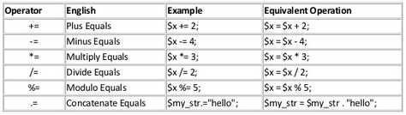
Combination Arithmetic & Assignment Operators
<?php
$a = 10; // Assignment operator
$a += 1; //11
$a -= 1; //9
$a *= 5; // 50
$a /= 2; //5
$a %= 3; // 1
$a .= “Hello”; // $a . “Hello”
?>
Henry, C-DAC

Slide 55
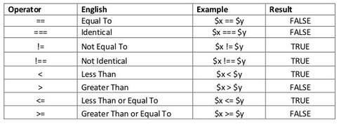
Comparison Operators
Comparison (==, ===, !=, !==, <, >, <=, >=)
<?php
// Equivalence
if (2 == 3) {echo 'No'; }
if (3 == '3') { echo 'Yes'; }
if (2 != 3) { echo 'Yes'; }
// Identical
if (3 === '3') { echo 'No'; }
if (3 === 3) { echo 'Yes'; }
?>
Henry, C-DAC

Slide 56
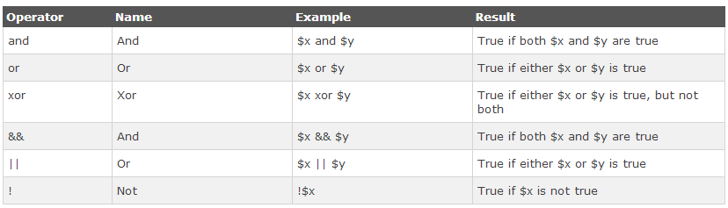
Logical Operators
Henry, C-DAC

Slide 57
String Operators
String concatenation (.)
<?php
$myString = 'foo' . 'bar'; // foobar
$myString .= 'baz'; //foobarbaz
?>
Henry, C-DAC

Slide 58
Strings & Interpolation
Single Quotes
<?php
$x = 2;
echo 'I ate $x cookies.';
?>
Double Quotes
<?php
$x = 2;
echo “I ate $x cookies.”;
?>
Output : I ate $x cookies.
Output : I ate 2 cookies.
Henry, C-DAC

Slide 59
Single Quote Vs Double Quote
Double Quotes are used to parse variable inside quotes.
  If your string start with double quote, then PHP automatically start searching for variables inside double quotes.
  If your string didn't contain any variable then it leads to waste of time
Single Quotes print the string as it is, it doesn’t parse variables inside single quotes.
  If your string didn't contain any variable then you must use Single Quote for that string.
  Single Quotes are faster then Double Quotes because single quote don’t look for variables inside quotes.
Henry, C-DAC

Slide 60
Constants
Defining
<?php
define('HELLO', 'Welcome, Acts course');
echo HELLO; // Welcome, Acts course
?>
As of PHP 5.3
<?php
const HELLO = 'Welcome, Acts course';
echo HELLO; // Welcome, Acts course
?>
Henry, C-DAC

Slide 61
Control Structure
Wide Variety available
  if, else, elseif
  Switch
  while, do-while
  for, foreach
  break, continue
  require, include, require_once, include_once
Henry, C-DAC

Slide 62
If, if/else, elseif
If
<?php
  If($a > 20) {
    print “$a is greater than 20”;
  }
?>
If/else
<?php
  If($a > 20) {
    print “$a is greater than 20”;
  } else {
  print “$a is less than 20”;
  }
?>
Henry, C-DAC

Slide 63
If, if/else, elseif
elseif
<?php
  If($a > 20) {
    print “$a is greater than 20”;
  } elseif($a < 10) {
  print “$a is less than 10”;
  } else {
  print “$a is between 10 & 20”;
  }
?>
Henry, C-DAC

Slide 64
Switch
Switch
<?php
$i = 1;
switch($i) {
case 0: print "i equals 0";break;
case 1: print "i equals 1";break;
case 2: print "i equals 2";break;
default:print "nothing";break;
}
?>
Henry, C-DAC

Slide 65
While, do-while
While
<?php
$i = 1;
while ($i <= 10) {
echo $i++; /* the printed value would be
$i before the increment
*/
}
?>
Henry, C-DAC

Slide 66
While, Do-while
Do-while
<?php
$i = 0;
do {
echo $i;
} while ($i > 0);
?>
Henry, C-DAC

Slide 67
For, foreach
for
<?php
for ($i = 1; $i <= 10; $i++) {
echo $i;
}
?>
Henry, C-DAC

Slide 68
foreach
The foreach loop works only on arrays, and is used to loop through each key/value pair in an array.
foreach ($array as $value) {
code to be executed;
}
For every loop iteration, the value of the current array element is assigned to $value and the array pointer is moved by one, until it reaches the last array element.
Henry, C-DAC

Slide 69
Foreach - example
<?php
$colors = array("red", "green", "blue", "yellow");
foreach ($colors as $value) {
echo "$value <br>";
}
?>
Henry, C-DAC

Slide 70
Foreach - example
<?php
$colors = array("red", "green", "blue", "yellow");
foreach ($colors as $key => $value) {
echo "{$key} => {$value} ";
}
?>
Henry, C-DAC

Slide 71
break, continue
break
<?php
for ($i = 0; $i < 5; ++$i) {
if ($i == 2)
break;
print "$i\n";
}
?>
Henry, C-DAC

Slide 72
break, continue
continue
<?php
for ($i = 0; $i < 5; ++$i) {
if ($i == 2)
continue;
print "$i\n";
}
?>
Henry, C-DAC

Slide 73
PHP Date and Time
date()
d - Represents the day of the month (01 to 31)
m - Represents a month (01 to 12)
Y - Represents a year (in four digits)
l (lowercase 'L') - Represents the day of the week
echo "Today is " . date("Y/m/d") .
Henry, C-DAC

Slide 74
PHP – Set Timezone
<?php
date_default_timezone_set('Asia/Calcutta');
$timezone = date_default_timezone_get();
echo "The Current server timezone is " . $timezone;
$date_time = date('m/d/Y H:i:s', time());
echo "Today's date and time is" . $date_time;
?>
Henry, C-DAC

Slide 75
For Lab…
Environment
  Hostname: 10.180.8.220 (Linux)
  Username: dac1-dac50
  Password : actsdac1 (for all)
  Note: Change the password after first login
    $passwd
  Home directory: /var/www/html/dac1(50)
    Write your PHP programs under this folder
  Browser your PHP programs
    http://10.180.8.220/dac1(50)/hello.php
Henry, C-DAC

Slide 76
(OR) For Lab…Method (2)
Method 1: Access via Web-Shell
  https://10.180.8.220:4200/
  (or) Method 2: Access via PuTTY
  Login with username and password
  Use vi or nano editor to code
  Browse your PHP programs @ http://10.180.8.220/dac1(50)/prog1.php
Henry, C-DAC

